Slide 1
Installing Hdef
Matt Herman
Last updated

Slide 2
Requirements
Unix-style operating system: Mac OS, Linux, or WSL
GCC and Gfortran compilers (I cannot guarantee the software will work with other compilers)
LAPACK is required for some (not all) programs; for LAPACK installation instructions, see the Installing LAPACK tutorial
CMake

Slide 3
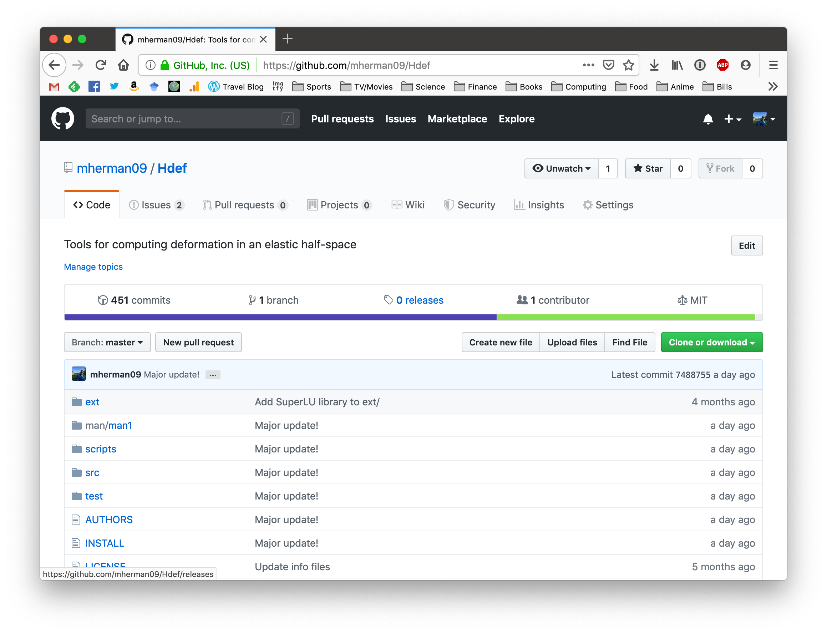
Downloading & Installing
If you use git, clone from:
https://github.com/mherman09/Hdef
and skip to Slide 9
Otherwise, download the package by going to this link in a browser

Slide 4
Downloading & Installing
Click here
https://github.com/mherman09/Hdef

Slide 5
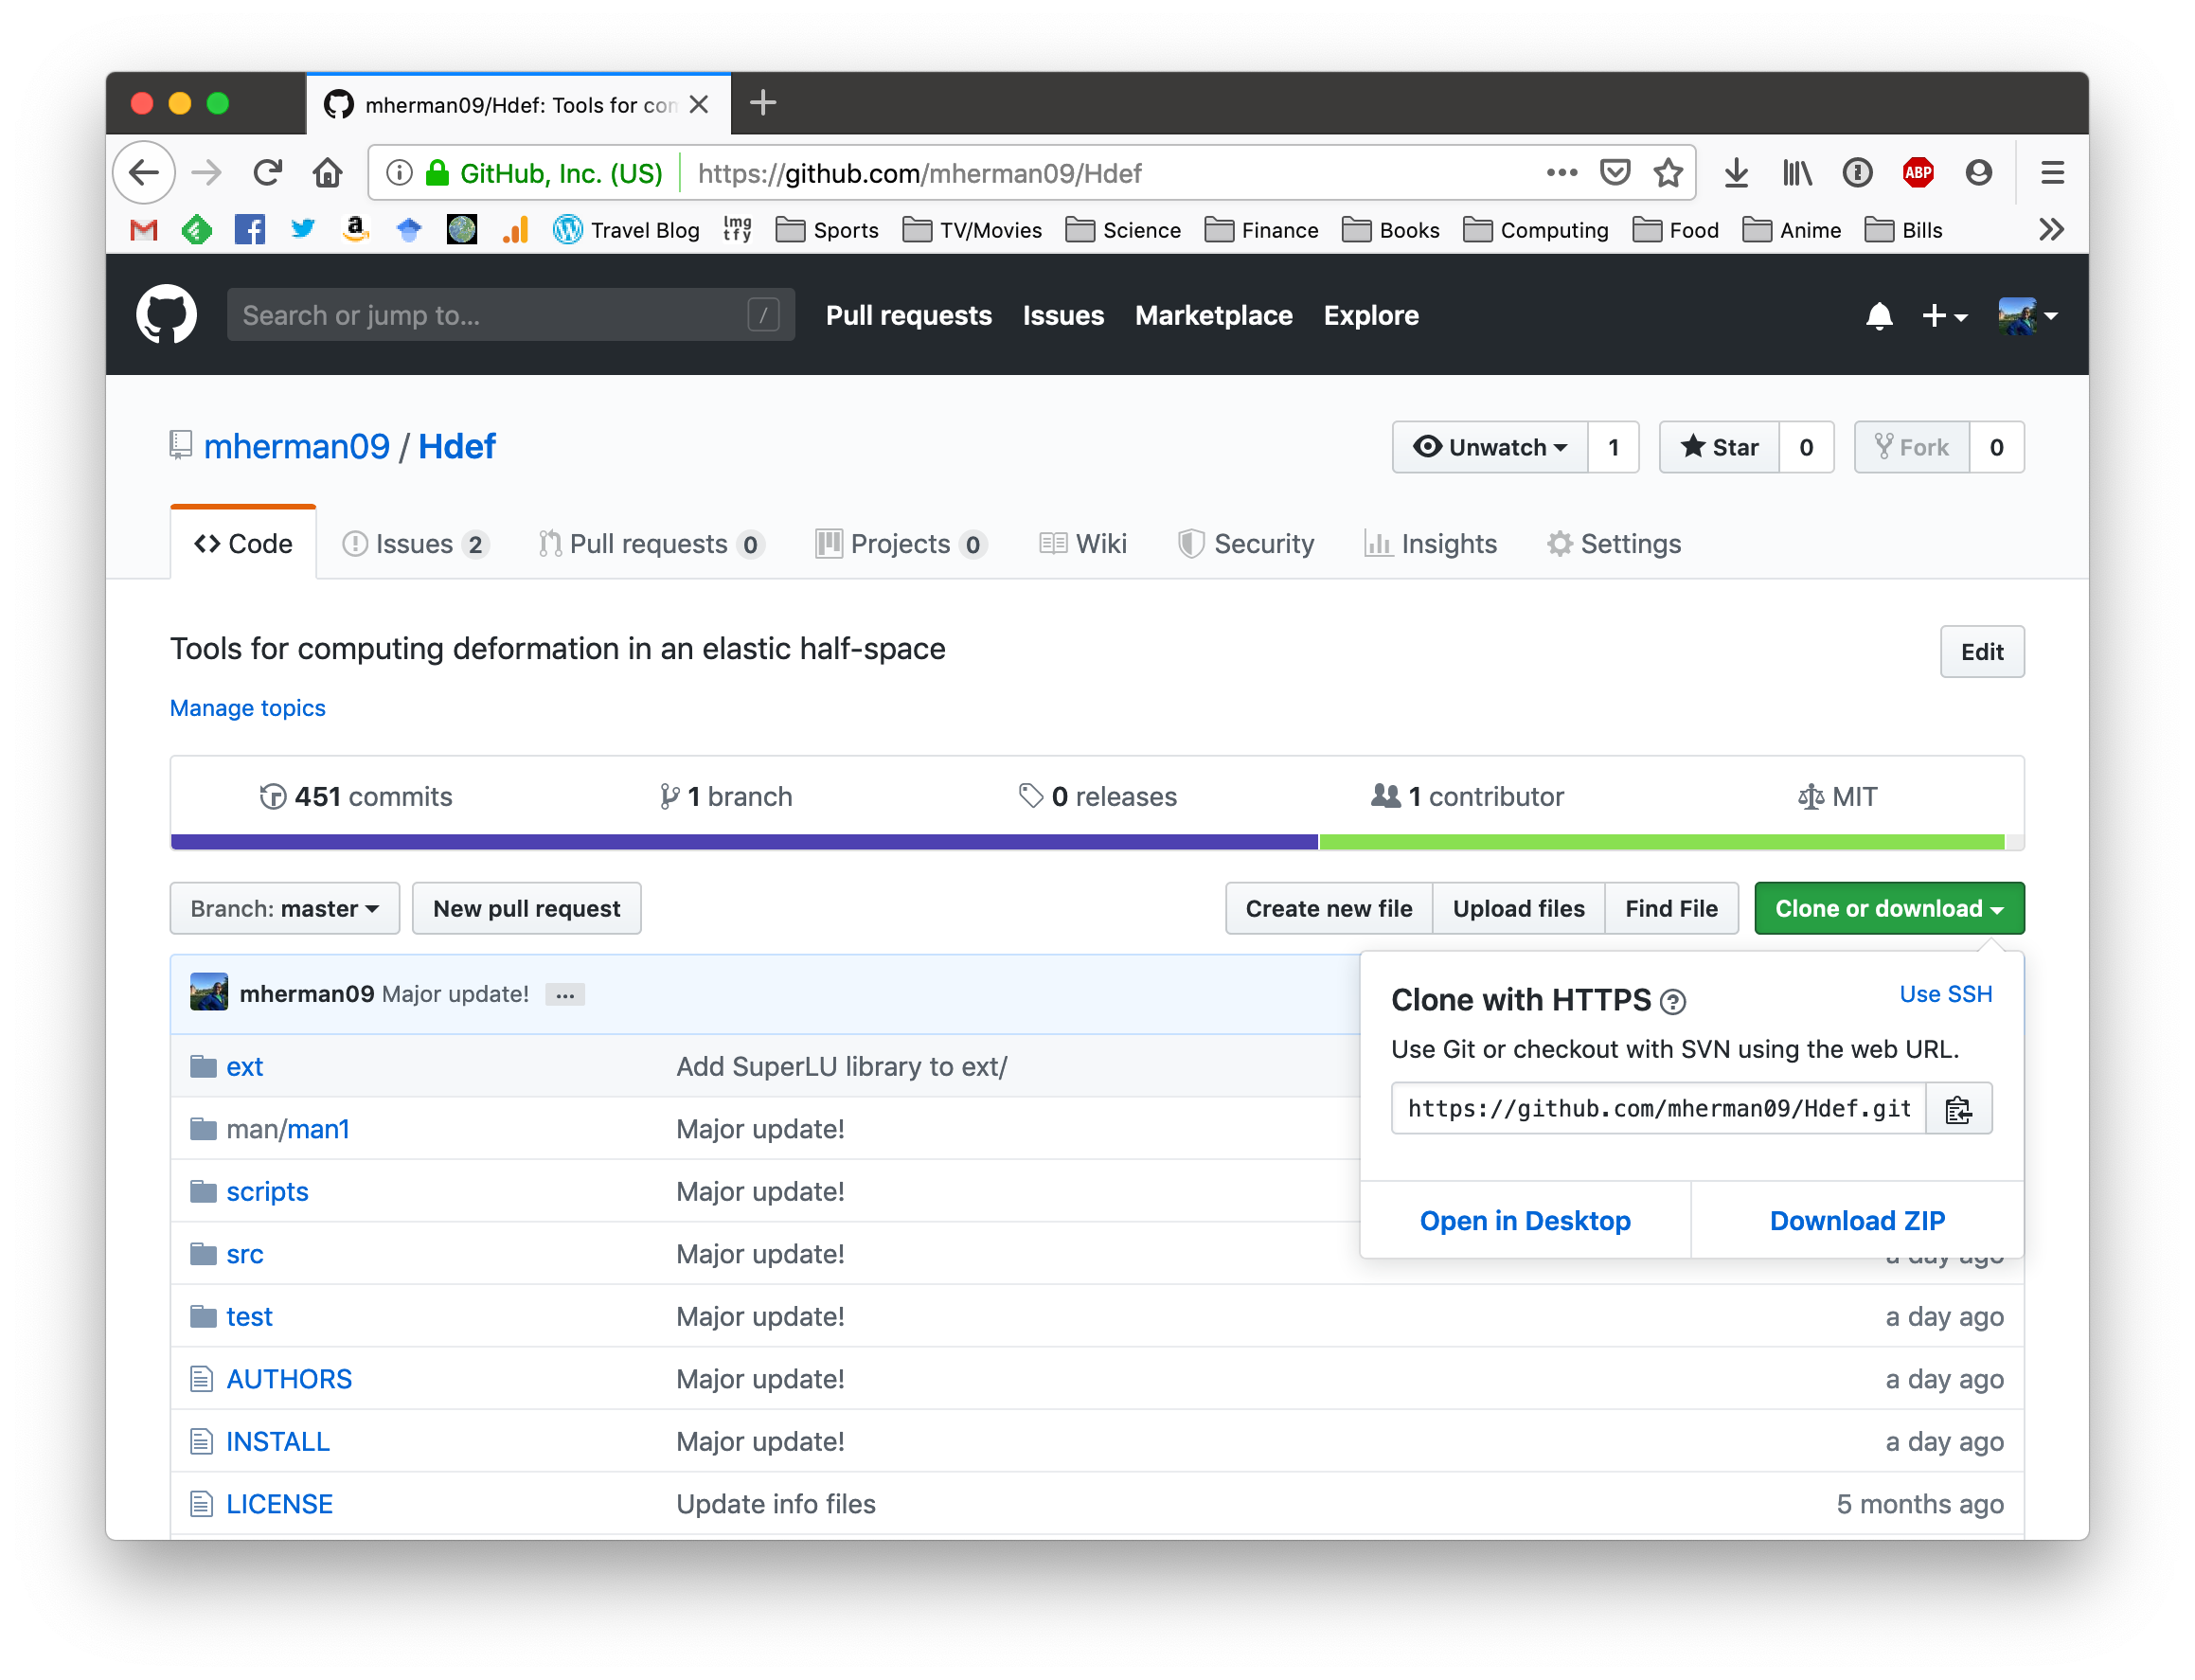
Downloading & Installing
Click here
https://github.com/mherman09/Hdef

Slide 6
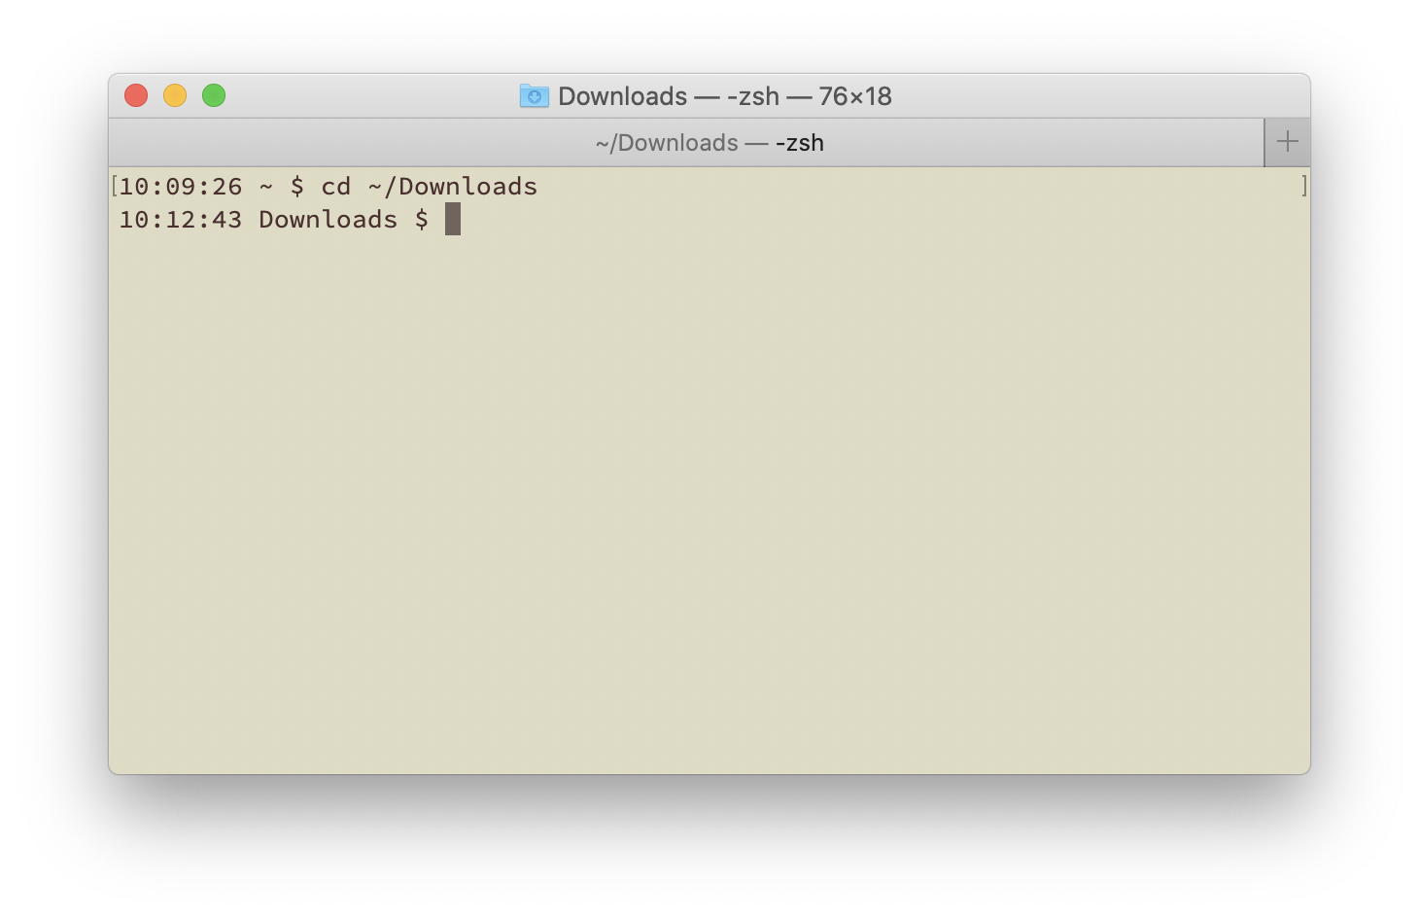
Downloading & Installing
Open a terminal window.
Change directory into ~/Downloads or wherever you saved the zip file.

Slide 7
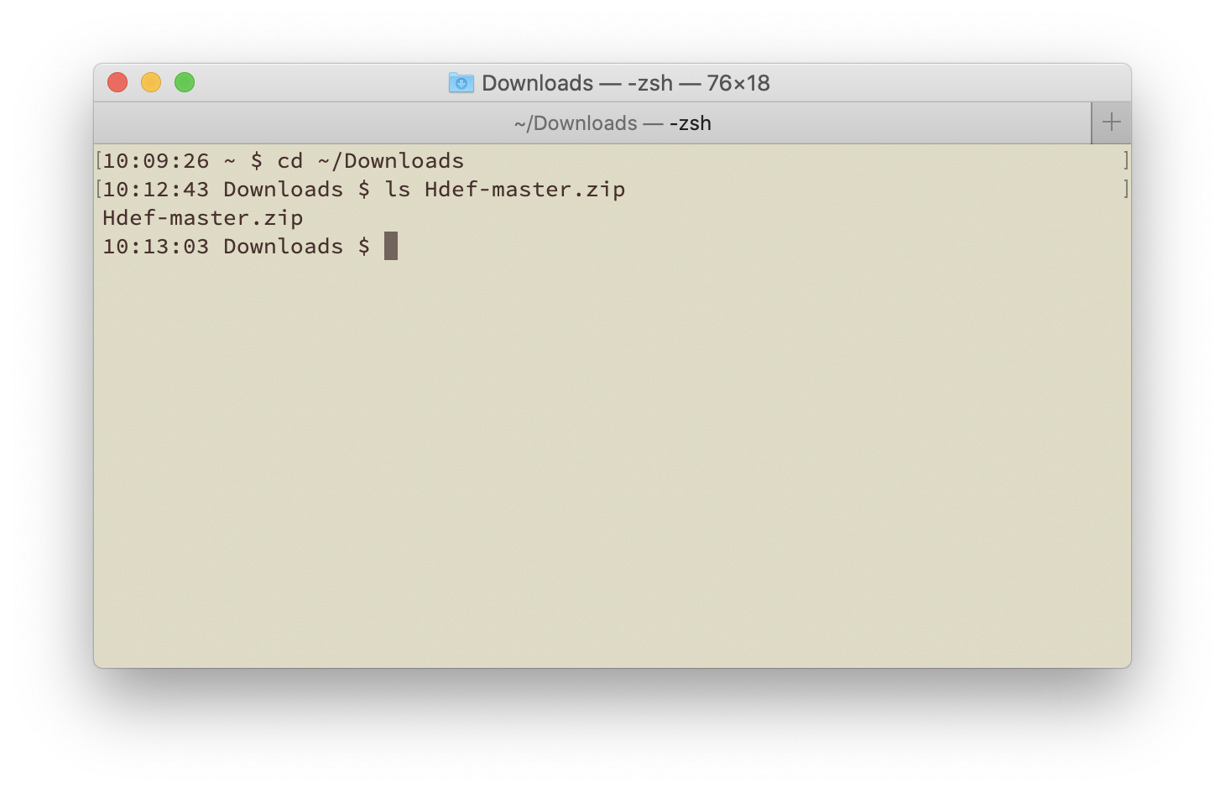
Downloading & Installing
The file name is Hdef-master.zip

Slide 8
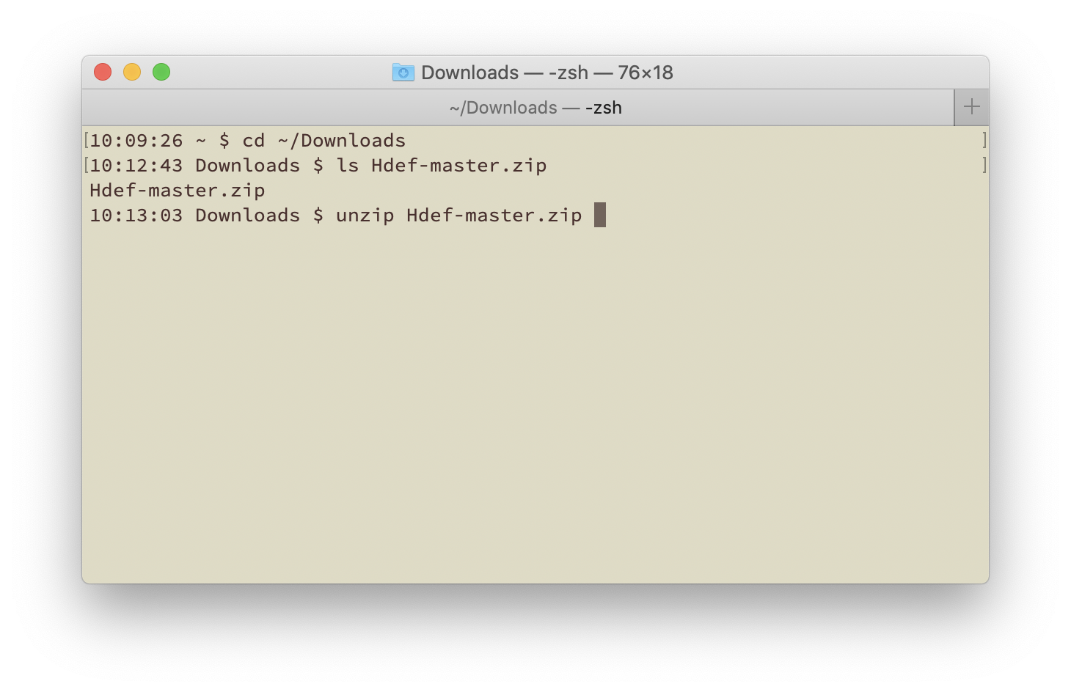
Downloading & Installing
Unzip the file.
The program “unzip” is available on most systems.

Slide 9
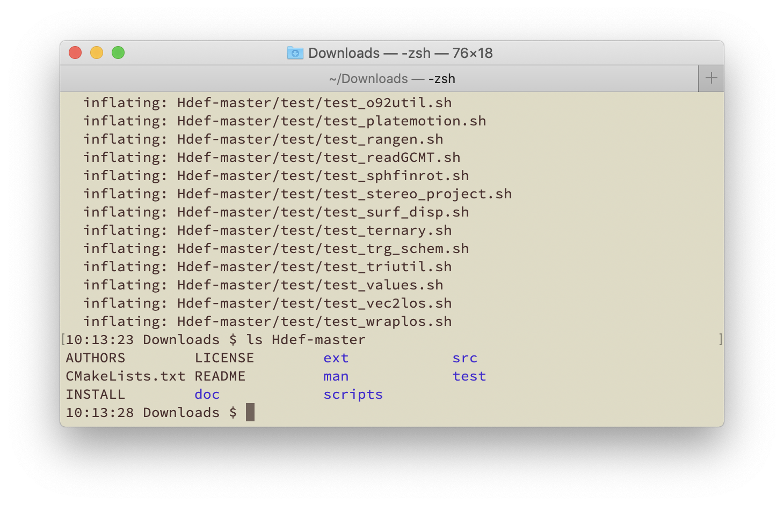
Downloading & Installing
You now have the directory Hdef-master/
Check what is inside. It should contain these files and directories.
If you cloned the Github repository, start from here

Slide 10
Downloading & Installing
The file INSTALL explains how to install the programs.
README contains other useful information
If you cloned the Github repository, start from here

Slide 11
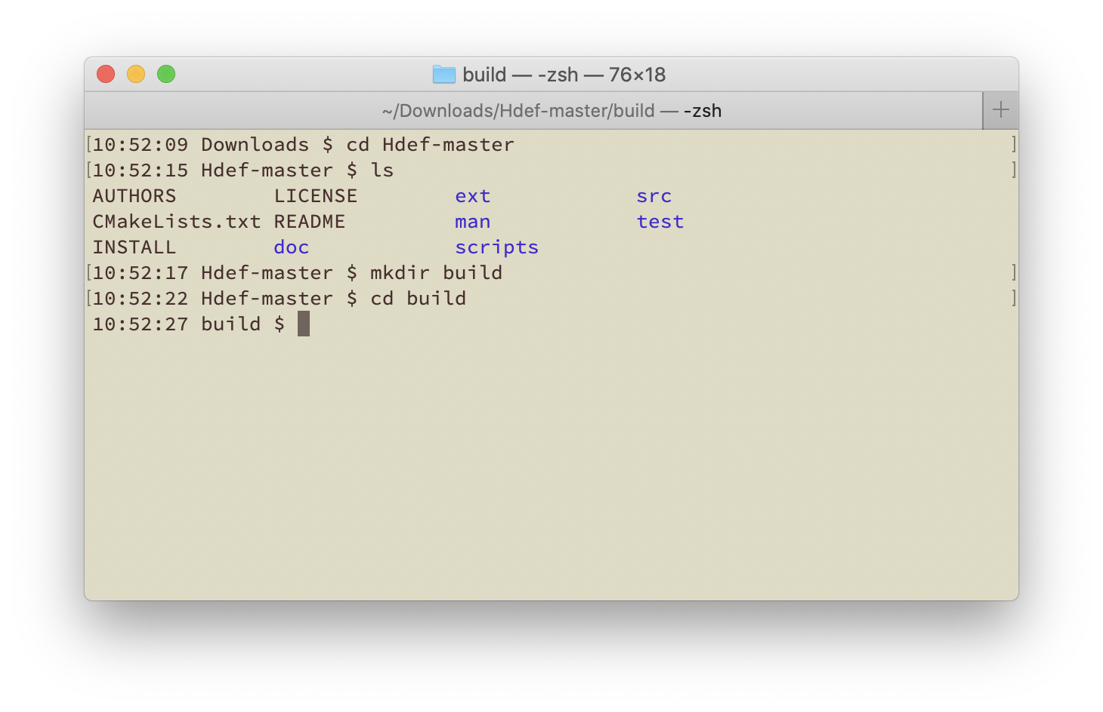
Downloading & Installing
Change into the Hdef directory
Make a new directory called build
Change into the build directory

Slide 12
LAPACK in Hdef
At this point, you need to decide whether you want to install Hdef with the linear algebra library LAPACK or not
The LAPACK functions are used in fitting curves and inversions
If you want to use LAPACK functionality, stop this tutorial now and go install LAPACK.
If you need help with this, check out the Installing LAPACK instructions

Slide 13
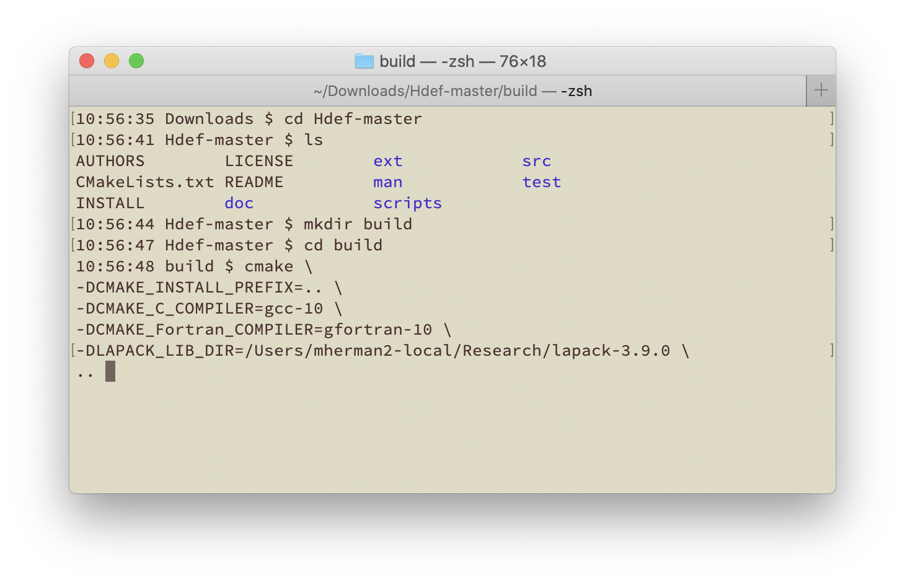
Downloading & Installing
From the build directory, run CMake with the flags shown here
Note: you can put all these flags on one line. I have put the flags on separate lines (with “\” at the end of each line) so you can read them more easily

Slide 14
Downloading & Installing
-DCMAKE_INSTALL_PREFIX: the location to install Hdef after it is built (I usually put everything in the main Hdef directory, hence “..” but you can choose a different installation directory if you organize your system differently)

Slide 15
Downloading & Installing
-DCMAKE_C_COMPILER: your C compiler
-DCMAKE_Fortran_COMPILER: your Fortran compiler

Slide 16
Downloading & Installing
-DLAPACK_LIB_DIR: the location where you installed LAPACK (if you are not using LAPACK, you can omit this flag)

Slide 17
Downloading & Installing
Do not forget the “..” at the end of the argument list!
This tells CMake where to find the instructions for configuring and building Hdef

Slide 18
Downloading & Installing
Press return and wait a few seconds for configuration…

Slide 19
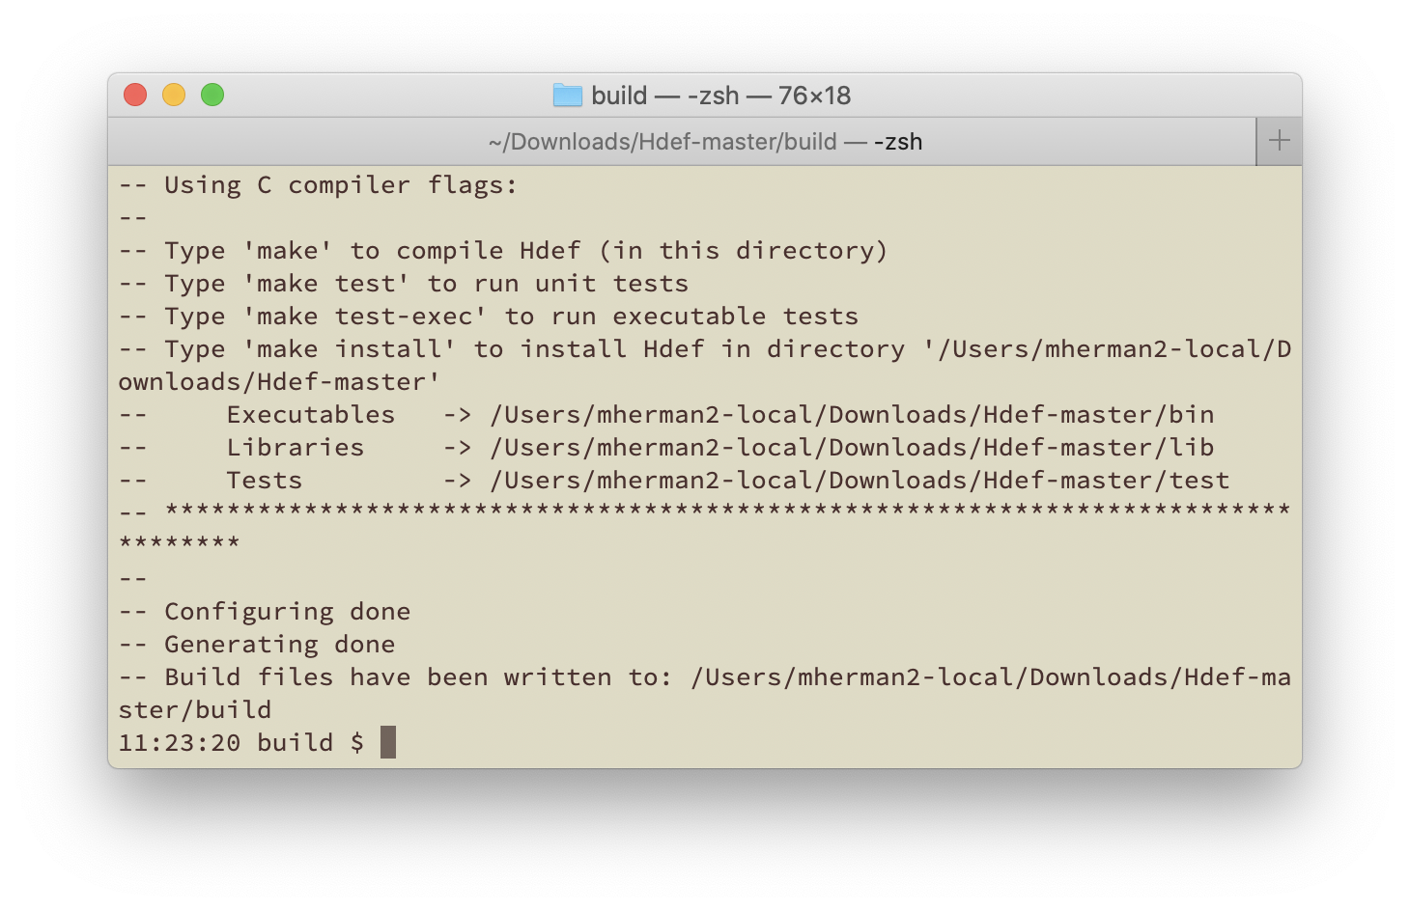
Downloading & Installing
At the end of configuration, information is provided for how to build Hdef and where files will be placed. If anything is wrong, run CMake again with the correct options.

Slide 20
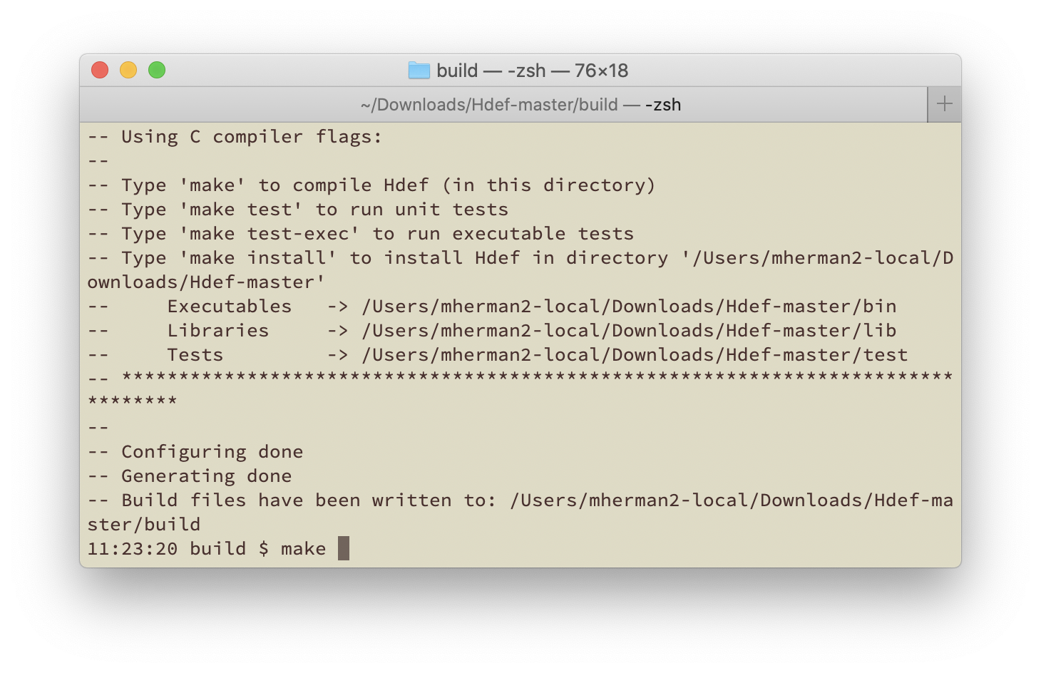
Downloading & Installing
Type make to build Hdef…this takes a few seconds

Slide 21
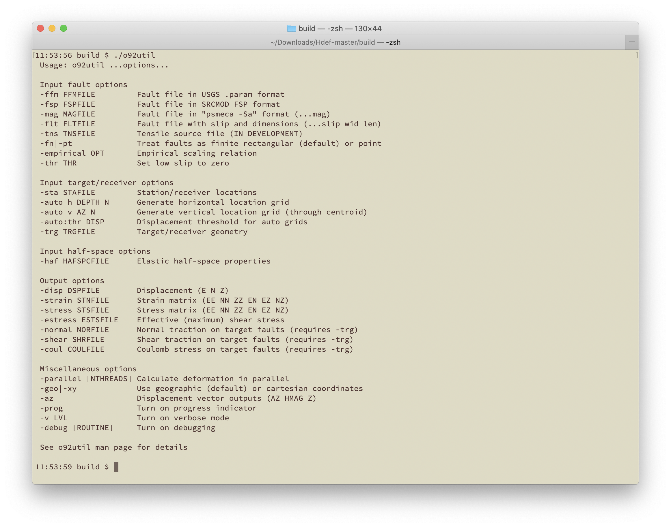
Downloading & Installing
If there are no errors, Hdef has been built. You can check this by typing ./o92util – if the usage statement prints, then the program has been compiled in the build directory

Slide 22
Downloading & Installing
Hdef has been built, so you could stop here!
To test the programs, type make test. If Hdef is built correctly, all tests should pass. This goes quickly, so I highly recommend testing!
To install the programs in the directory you indicated when running CMake, then type make install

Slide 23
Downloading & Installing
Last but not least, you need to tell your computer where to find the installed programs by adding the Hdef directory (e.g., /path/to/Hdef/bin) to your PATH environment variable
The syntax depends on your shell (type “echo $SHELL” to see which shell you are using):
Bash: add the following line to .bashrc:
export PATH=$PATH:/path/to/Hdef/bin
Zsh: add the following line to .zshrc:
export PATH=$PATH:/path/to/Hdef/bin
Csh: add the following line to .cshrc:
setenv PATH $PATH:/path/to/Hdef/bin

Slide 24
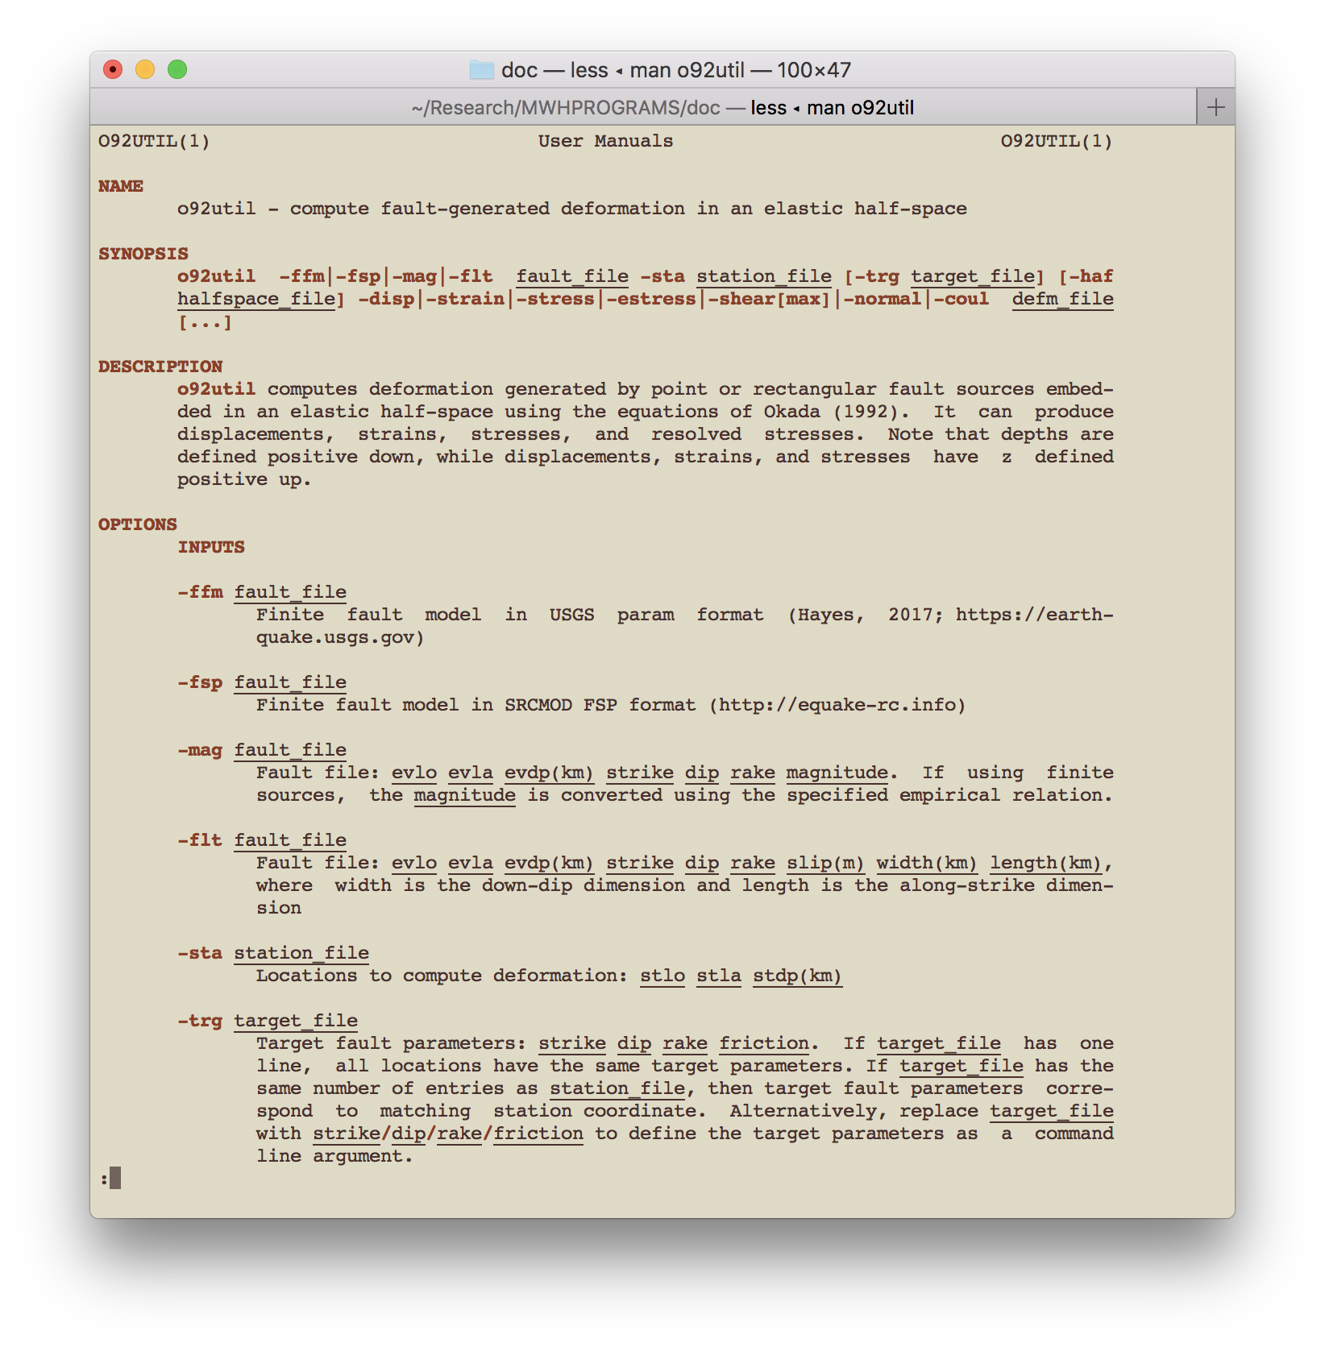
Downloading & Installing
There are man pages for several of the tools. These may be particularly useful for the larger programs with lots of options. These are in the directory:
Hdef-master/man
Add these to the MANPATH variable in your .bashrc, .zshrc, .cshrc, etc.

